Slide 1

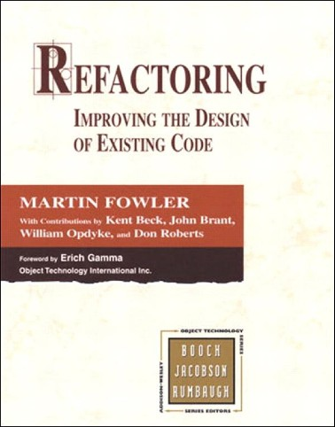
Refactoring:
Improving the Design of Existing Code
One of the best references on software refactoring, with illustrative examples in Java:
Refactoring: Improving the Design of Existing Code.
Martin Fowler. Addison Wesley, 2000. ISBN: 0201485672
See also www.refactoring.com Overview of this presentation
Refactoring basics
Categories of refactoring
2

Slide 2
Categories of refactorings (according to [Fowler2000])
Small refactorings
(de)composing methods [9]
moving features between objects [8] organizing data [16]
dealing with generalisation [12] simplifying method calls [15]
Big refactorings
Tease apart inheritance
Extract hierarchy
Convert procedural design to objects Separate domain from presentation

Slide 3

Big refactorings
Require a large amount of time (> 1 month)
Require a degree of agreement among the development team
No instant satisfaction, no visible progress

Slide 4


Big Refactorings
Tease apart inheritance
Extract hierarchy
Convert procedural design to objects
Separate domain from presentation

Slide 5


Big refactorings:
1. Tease apart inheritance
Problem
A tangled inheritance hierarchy that is doing 2 jobs at once
Solution
Create 2 separate hierarchies and use delegation to invoke one from the other

Slide 6

Big refactorings:
1. Tease apart inheritance
Approach
Identify the different jobs done by the hierarchy. Extract least important job into a separate hierarchy.
Use extract class to create common parent of new hierarchy. Create appropriate subclasses.
Use move method to move part of the behaviour from the old hierarchy to the new one.

Slide 7
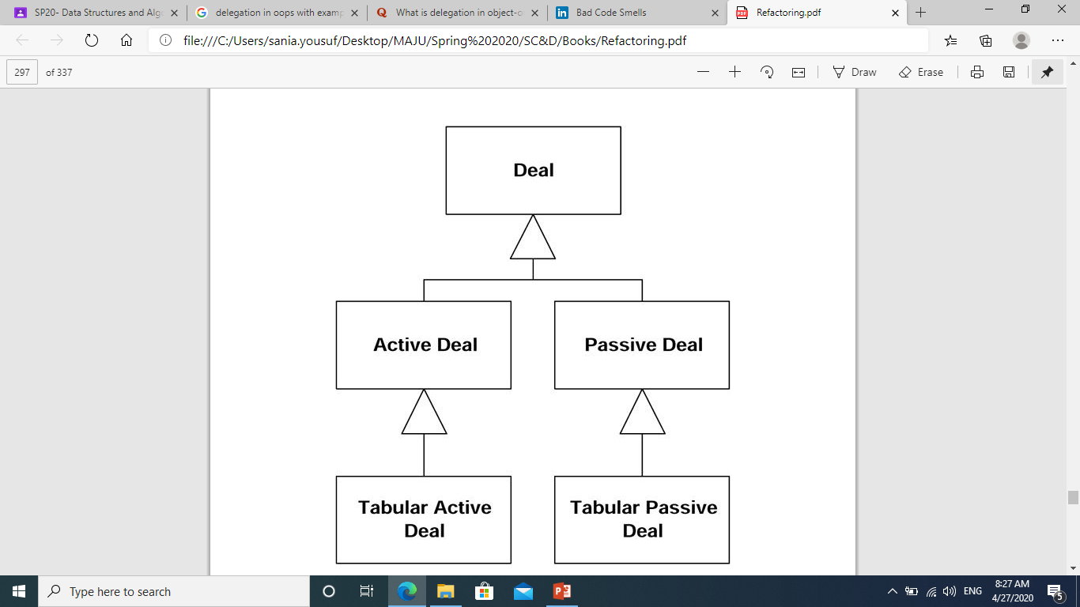
Big refactorings:
1. Tease apart inheritance

Slide 8
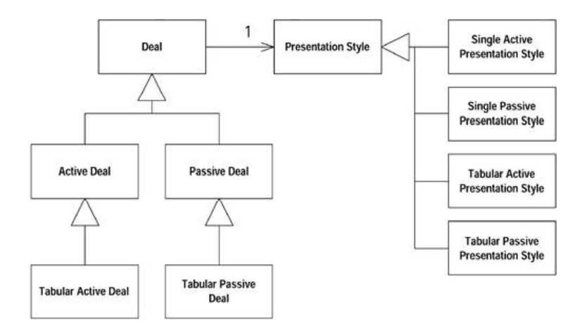
Big refactorings:
1. Tease apart inheritance

Slide 9
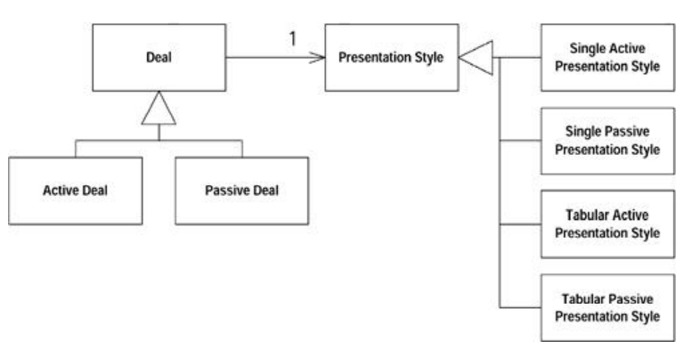
Big refactorings:
1. Tease apart inheritance

Slide 10
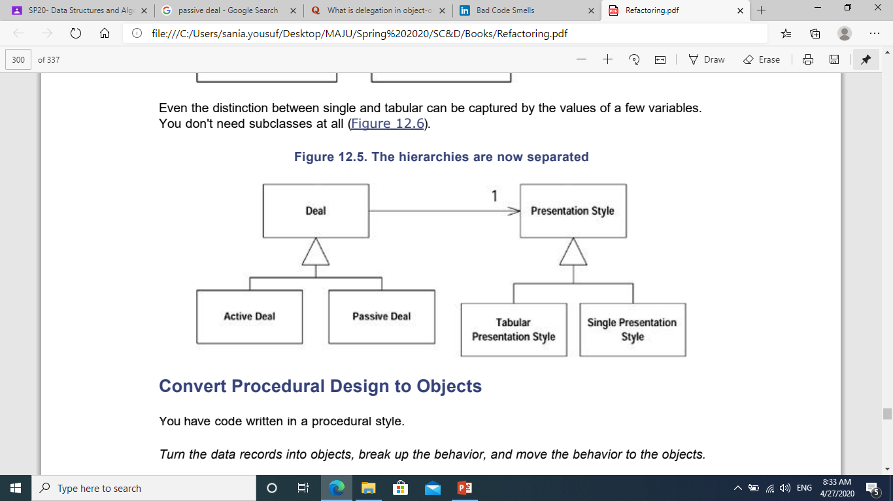
Big refactorings:
1. Tease apart inheritance

Slide 11
Big refactorings:
1. Tease apart inheritance

Slide 12

Big refactorings:
2. Extract hierarchy
Problem
An overly-complex class that is doing too much work, at least in part through many conditional statements.
Solution
Turn class into a hierarchy where each subclass represents a special case.

Slide 13
Big refactorings:
2. Extract hierarchy
Approach
Create a subclass for each special case.
Use one of the following refactorings to return the appropriate subclass for each variation:
replace constructor with factory method replace type code with subclasses
replace type code with state/strategy
Take methods with conditional logic and apply: replace conditional with polymorphism

Slide 14

Big refactorings:
2. Extract hierarchy (example)
Calculating electricity bills.
Lots of conditional logic needed to cover many different cases:
Customer
different charges for summer/winter
different tax rates
different billing plans for personal / business / government / …
reduced rates for persons with disabilities or social security
Billing Scheme

Slide 15
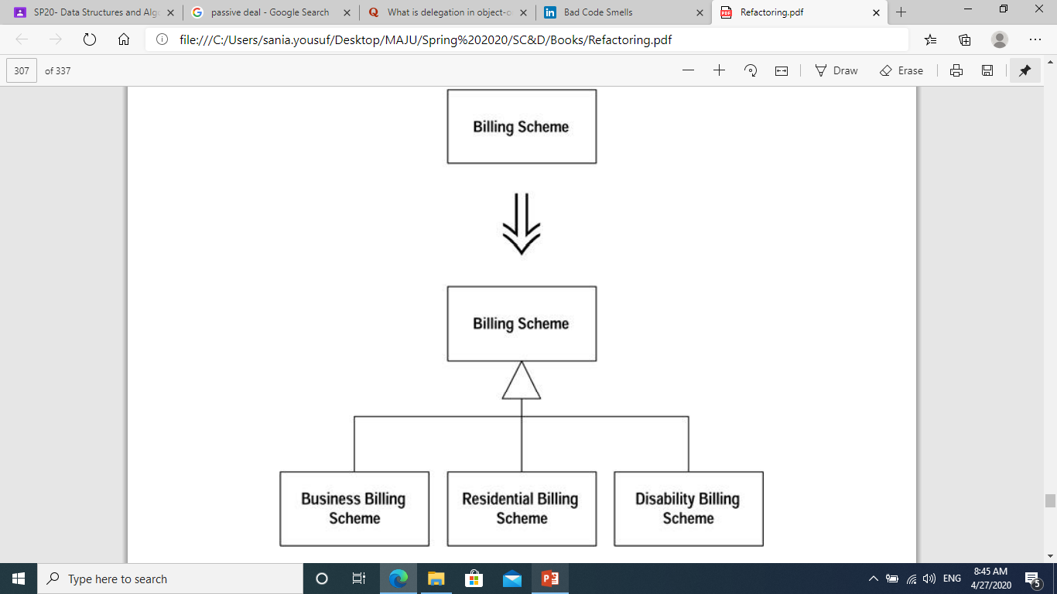
Big refactorings:
2. Extract hierarchy (example)

Slide 16


Big refactorings:
3. Convert procedural design into objects
Problem
You have code written in a procedural style.
Solution
Turn the data records into objects, break up the behaviour, and move the behaviour to the objects.
Smaller refactorings used
extract method, move method, …

Slide 17


Big refactorings:
4. Separate domain from presentation
Goal
Change a two-tier design (user interface/database) into a a three-tier one (UI/business logic/database).
Solution
Separate domain logic into separate domain classes.
Smaller refactorings used
extract method, move method/field, duplicate observed data, …

